Slide 1
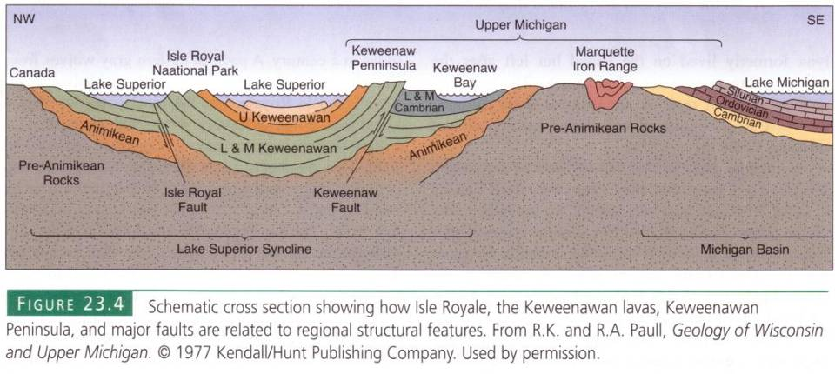
Notes:
It is tempting to link the Lake Superior Syncline to the downward folded rocks of the Michigan Basin, …

Slide 2
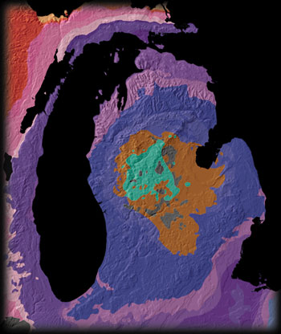
Notes:
… but the age of folding in the Michigan Basin is Paleozoic rather than Proterozoic and the style of deformation is different too. The bulls-eye pattern of rock ages indicates a bowl-like structure for the Michigan Basin …

Slide 3
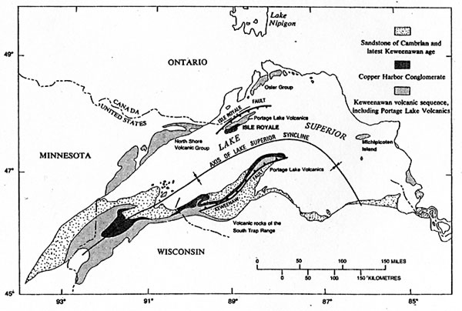
Notes:
... whereas the Lake Superior Syncline is more like a long trough.

Slide 4
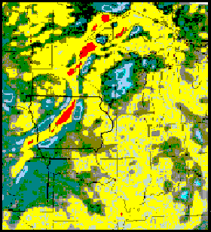
Basalt makes gravity stronger!
Notes:
Because that trough is filled with a lot of relatively dense basalt, the pull of gravity is a little bit stronger there. The red areas on this map indicate where the pull of gravity is abnormally high. Note they form a belt that runs from Lake Superior southwestward across the heart of the Midwest. The gravity anomaly is particularly strong in central Iowa …

Slide 5
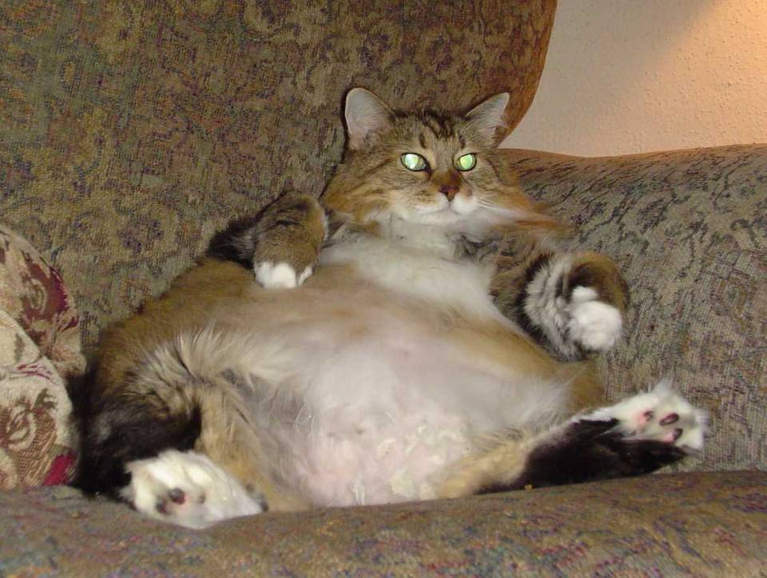
Typical central Iowan feline.
Notes:
… where most residents are completely unaware of the oppressive gravitational hazard that lies below.

Slide 6
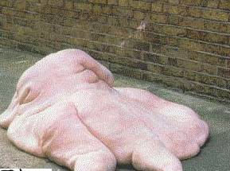
Mid-Continent Gravity Anomaly Victim
Notes:
Sadly, there is little that can be done for the most severely affected.

Slide 7
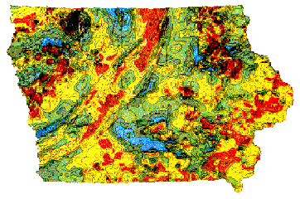
Basalt also contains a lot of magnetite.
Notes:
The basalt-filled rift valley also shows up on magnetic surveys because basalt contains a lot of the highly magnetic mineral magnetite.

Slide 8
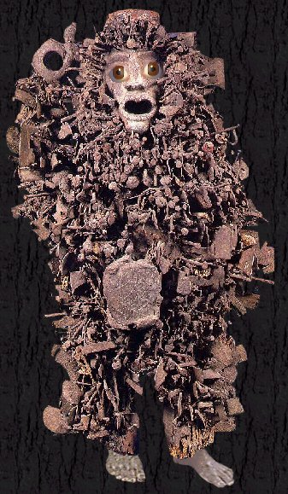
I’m not very popular with airport security.
Basalt contains a lot of magnetite.
Notes:
We have only recently become aware of how serious this environmental threat is.

Slide 9
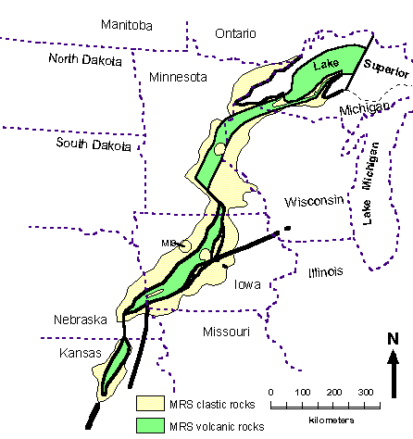
Notes:
Sedimentary rocks completely filled the failed rift, so there is little current topographic expression of the allochogen - other than Lake Superior where glacial erosion removed the rift’s softer sediments and helped form the deep basin now filled with the largest freshwater lake in the world.

Slide 10
copper
Notes:
During the interval when the rift was volcanically active, or shortly thereafter while those rocks were still warm, native copper deposits where emplaced.

Slide 11
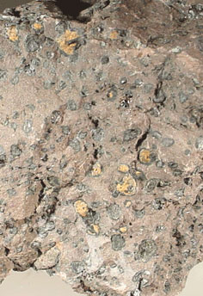
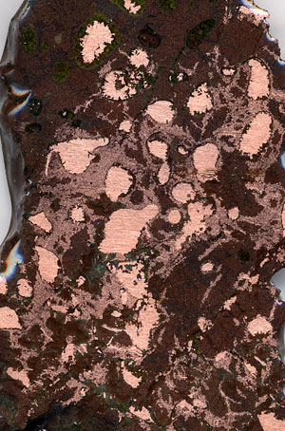
Notes:
The term native here implies that the copper is not compounded with any other element. Virtually pure copper is often found filling the amygdules …

Slide 12
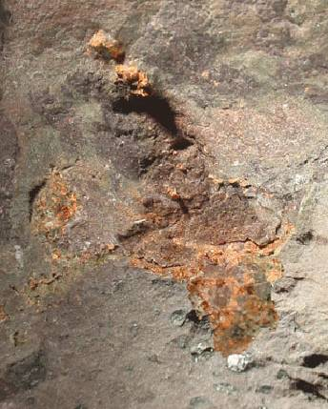
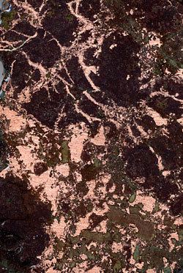
Notes:
… or just about any crack or pore in the basalt or conglomerate.

Slide 13
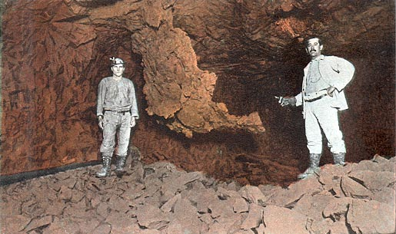
Notes:
Some of the largest native copper masses ever found were mined from Isle Royale mostly in the 1870’s …

Slide 14
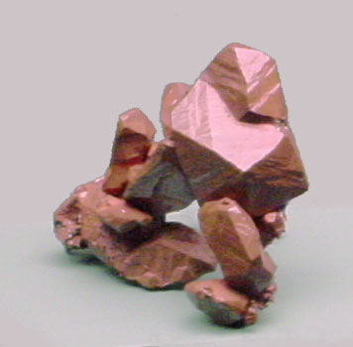
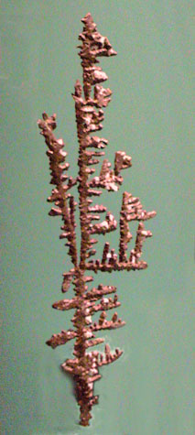
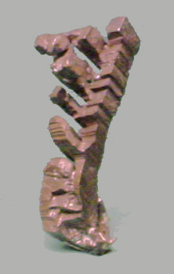
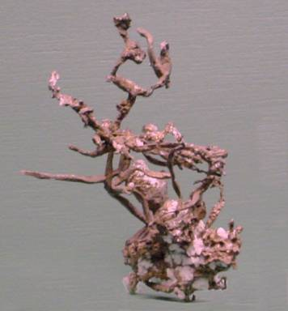
Notes:
…. as well as several museum quality specimens that illustrate copper’s crystal habit and …

Slide 15
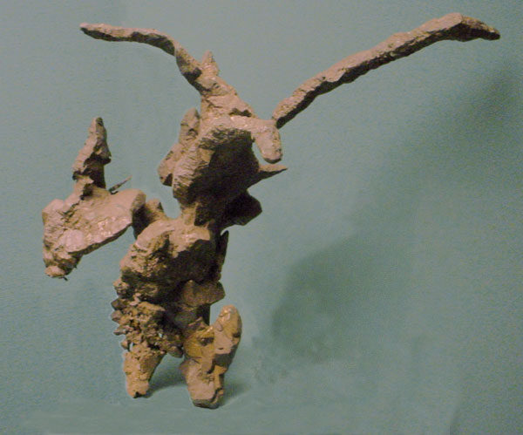
Notes:
… variable forms.

Slide 16
Hydrothermal circulation
Notes:
Although no single theory for the origin of the copper deposits has been universally accepted, most involve the action of circulating hydrothermal solutions. These either brought copper-bearing solutions towards the surface from crystallizing magma at depth or leached the copper from the basalts themselves and re-precipitated it in pore spaces where the hydrothermal solutions cooled.

Slide 17
erosion
Notes:
Throughout the Paleozoic, Mesozoic and Cenozoic the area was tectonically inactive and underwent a prolonged period of erosion …

Slide 18
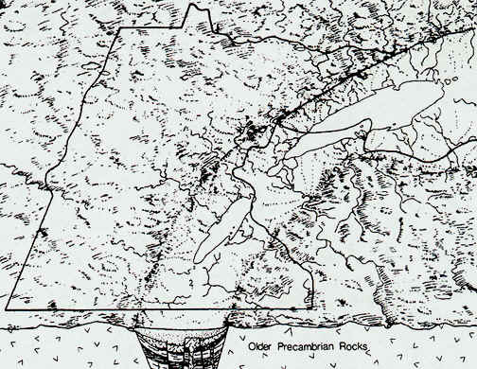
Notes:
… which essentially peneplaned the region. During the Pleistocene epoch, thick continental glaciers extended from Canada across this area …

Slide 19
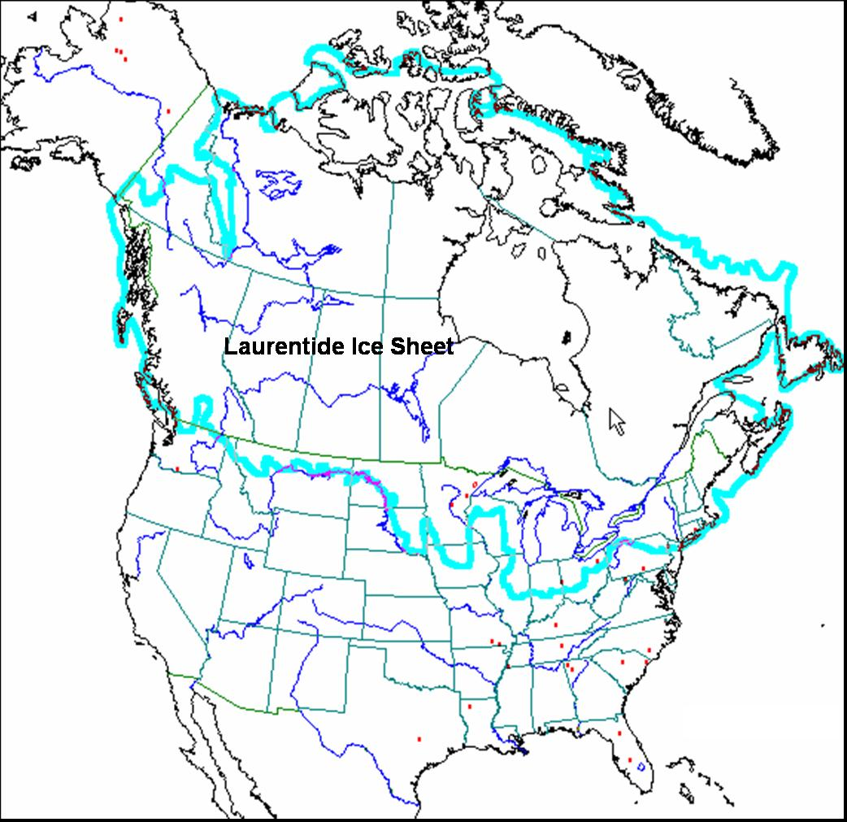
Notes:
… to as far south as central Illinois.

Slide 20
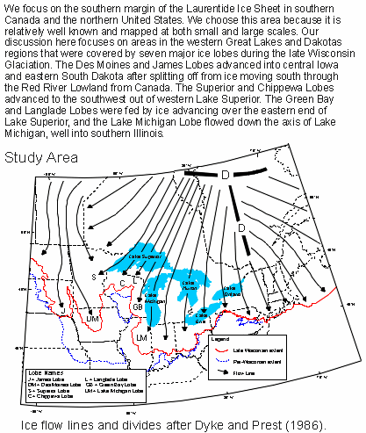
Notes:
The direction in which the continental ice sheets moved across Isle Royale was almost exactly parallel to the strike of the Proterozoic basalts and conglomerate there.

Slide 21
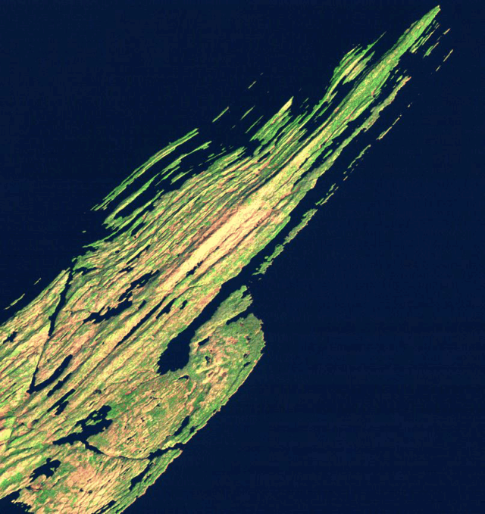
Notes:
So glacial erosion enhanced the island’s preexisting grain.

Slide 22
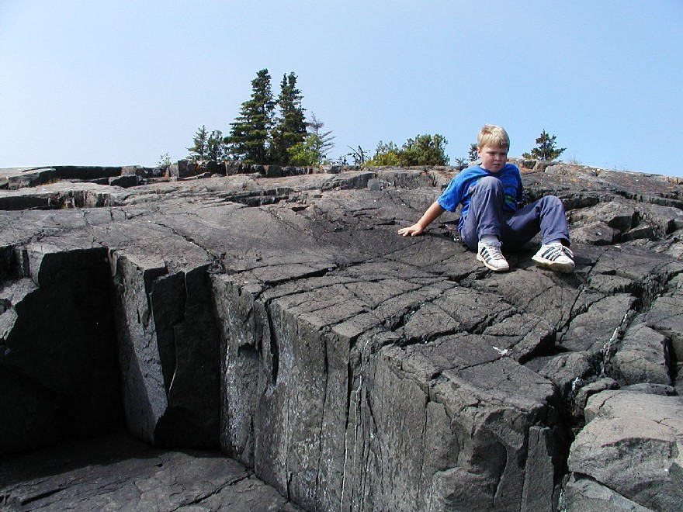
Notes:
There are numerous places on the island where one can see where glacial action has polished ...

Slide 23
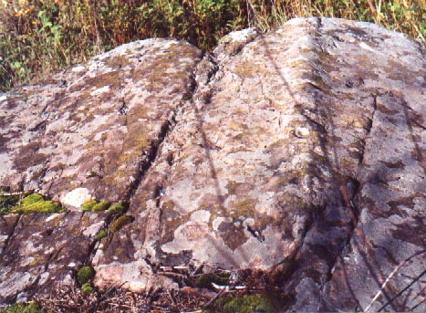
Notes:
… or grooved rock surfaces.

Slide 24
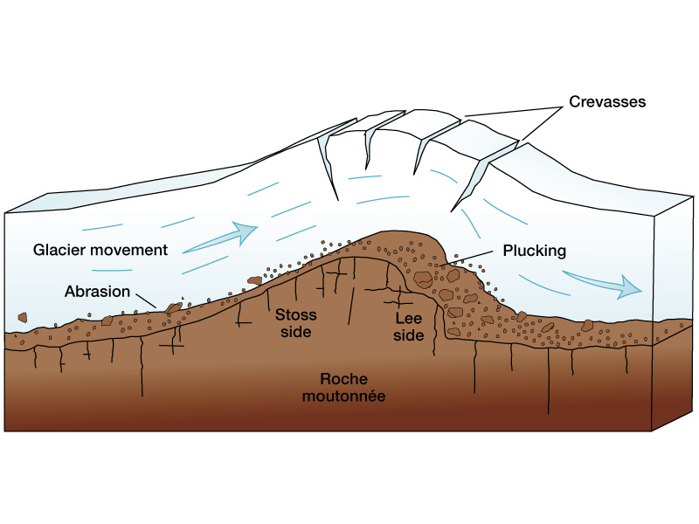
Notes:
As glaciers move across resistant rocks, asymmetrical ridges form because abrasion occurs on the side of ridge from whence the glacier comes (Stoss side), whereas ice plucking occurs on the Lee side. Such ridges are called Roche Moutonnée (rock sheep) …

Slide 25
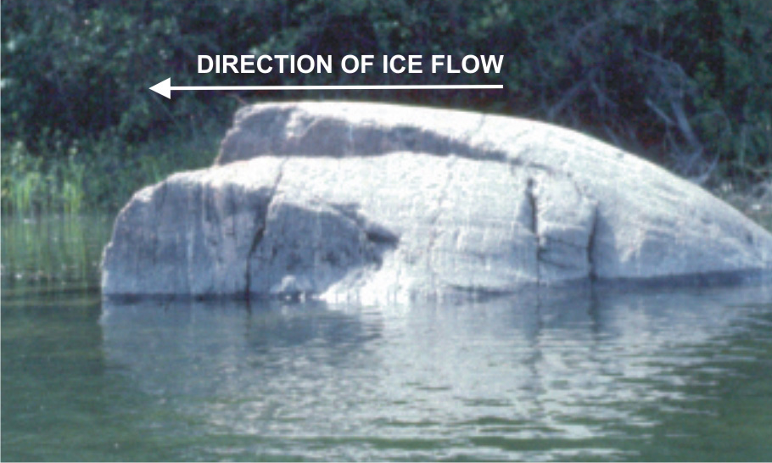
Roche Moutonnée
Notes:
… because they resemble sleeping sheep.

Slide 26
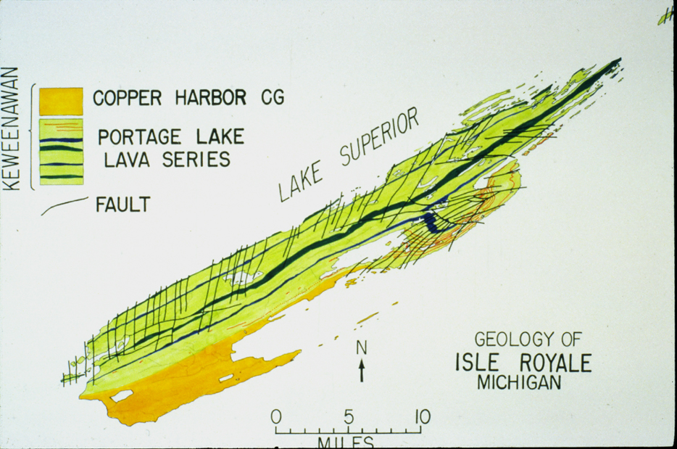
Notes:
Supposedly Roche Moutonnees formed along the most resistant lava flows of Isle Royale …

Slide 27
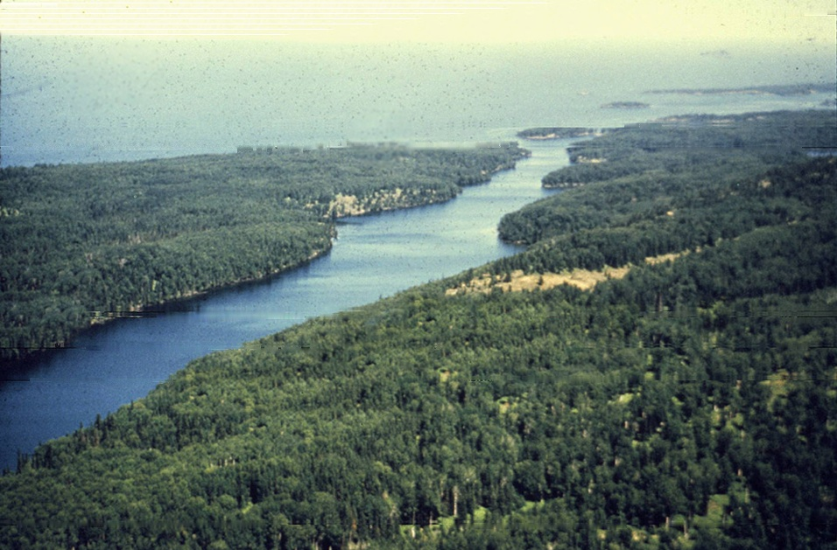
Notes:
… but I could find no obvious examples.

Slide 28
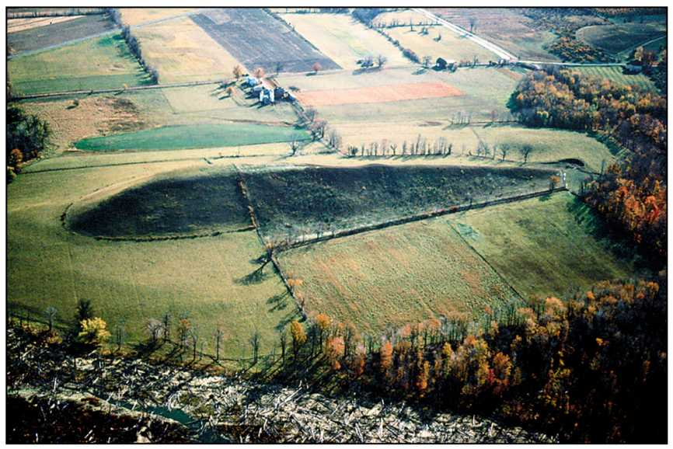
Drumlin
Notes:
Drumlins are another glacial landform which is alleged to exist on Isle Royale. Although they abound in nearby Wisconsin, again I could find no Isle Royale examples to show you.

Slide 29
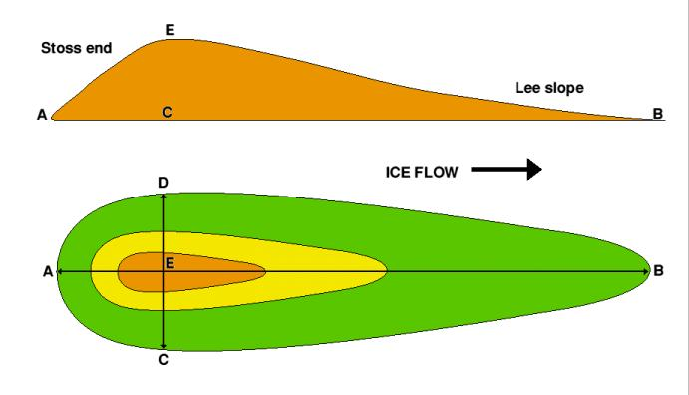
Notes:
They form in unconsolidated material - not rock, and they have the opposite asymmetry as Roche Moutonnees. The lee slope here is gentler.

Slide 30
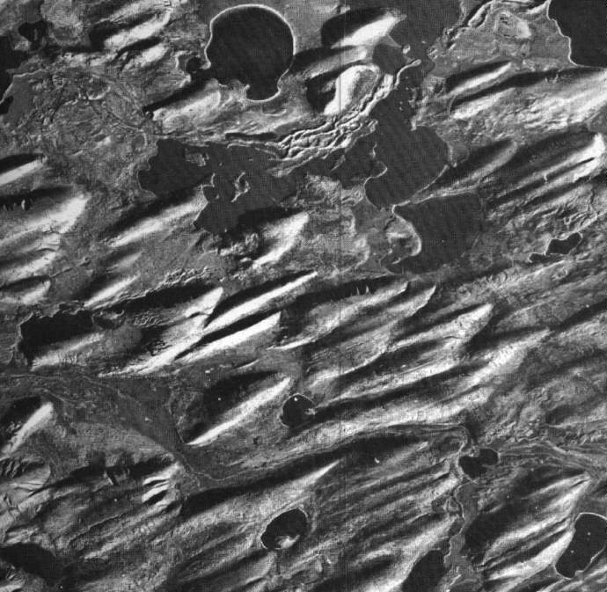
Notes:
Unlike the generally solitary Roche Moutonnees, drumlins typically occur in clusters.

Slide 31
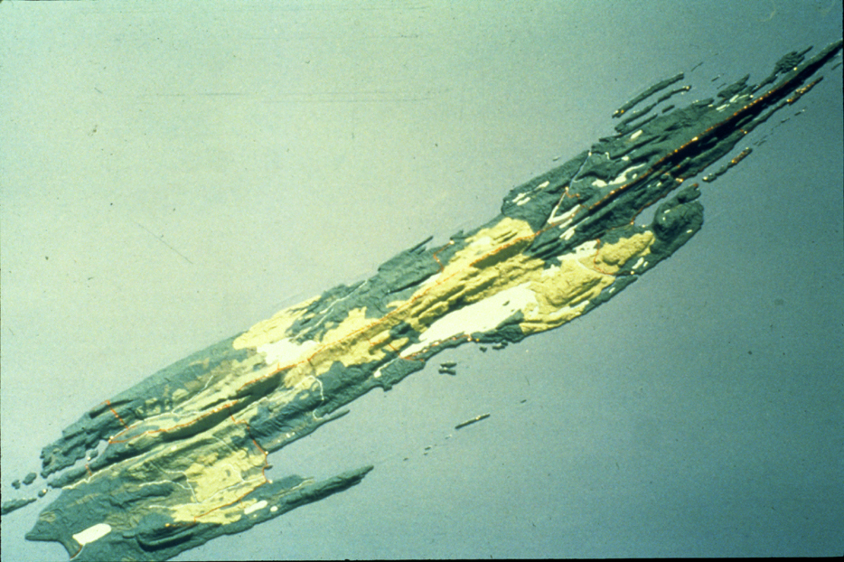
Notes:
Although glaciers where the dominant erosional agent which shaped the island, its shorelines were significantly modified by wave action.

Slide 32
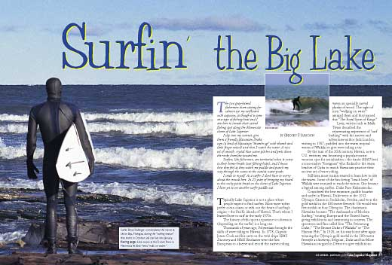
Notes:
Yes, there is surf in the Great Lakes! Remember that Lake Superior is the largest fresh water lake in the world …

Slide 33
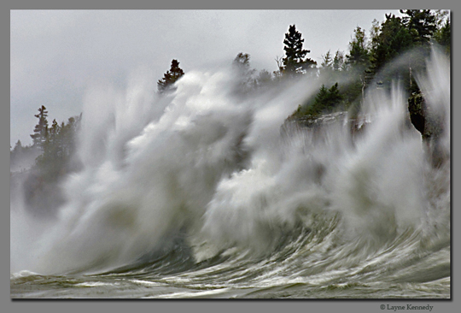
Lake Superior storm
Notes:
… and some pretty viscous storms blow across it.

Slide 34
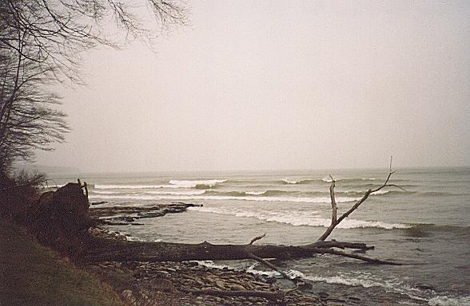
Notes:
Believe it or not this is Lake Superior …

Slide 35
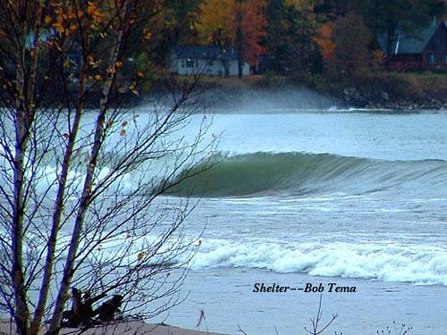
Notes:
… and so is this ….

Slide 36
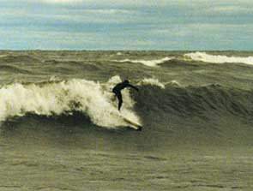
Notes:
… and this. So you can see that there are days when wave erosion is going to be aggressive.

Slide 37
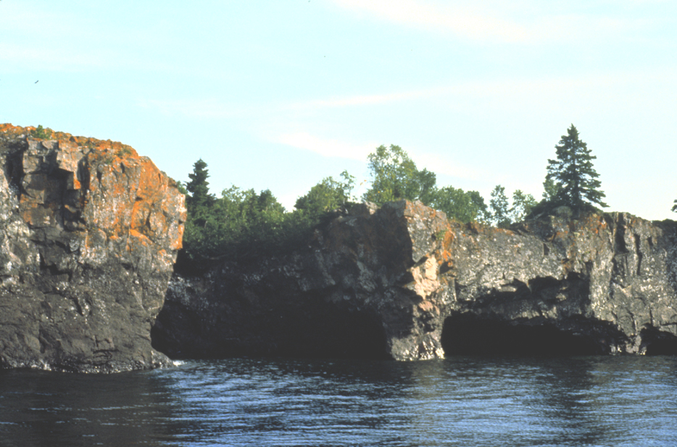
Sea cliffs and caves at Todd Harbor
Notes:
Wave eroded features occur on the most exposed shores and include sea cliffs, caves …

Slide 38
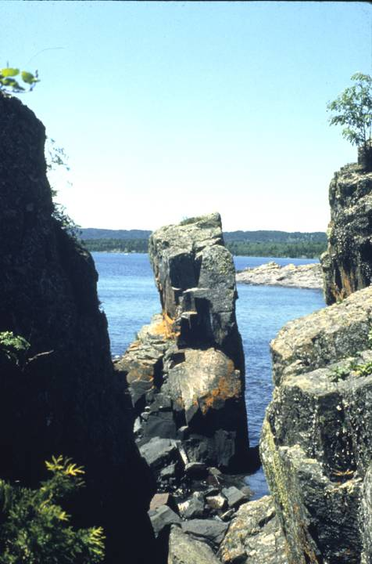
Notes:
… and countless sea stacks, which are remnants of wave eroded points.

Slide 39
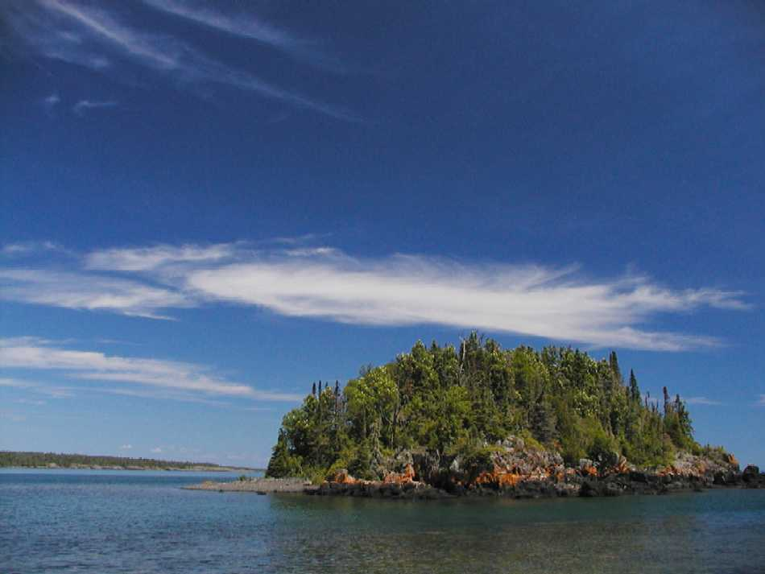
Notes:
Because they where detached from the point by wave erosion, sea stacks tend to have steep sides.

Slide 40
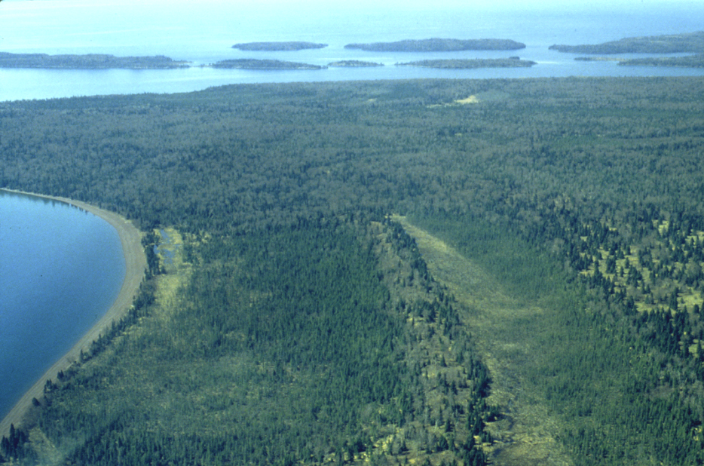
Ancient shorelines
Notes:
Finally, wave erosion tends to level the shallow, near-shore lake bottom while building a gravel berm on the shore. When the water level drops and/or the land uplifts, these features are exposed indicating the position of the former shorelines.

Slide 42
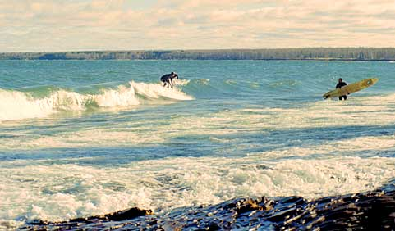

Slide 43
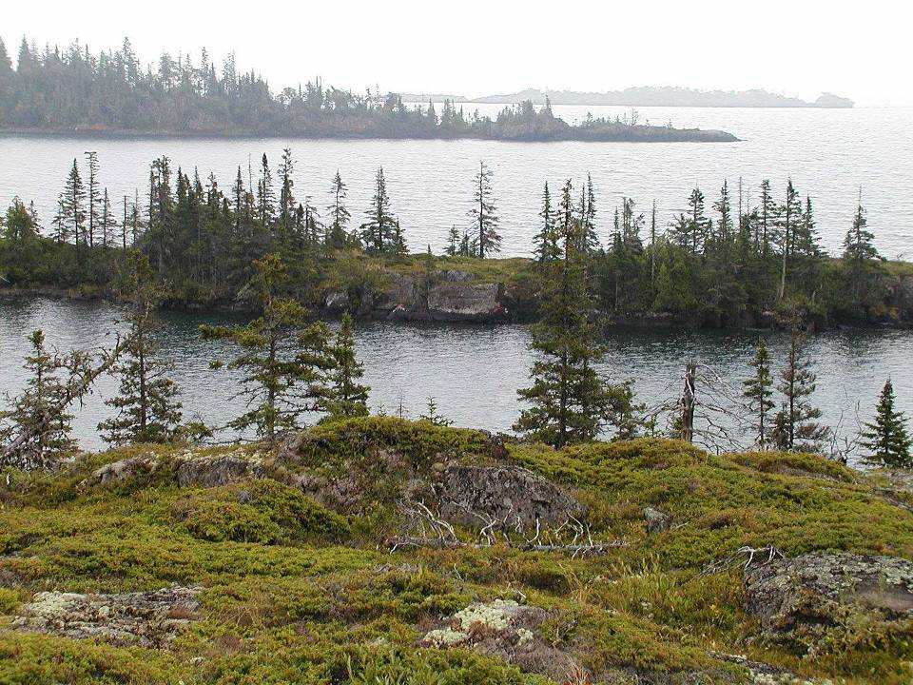

Slide 44
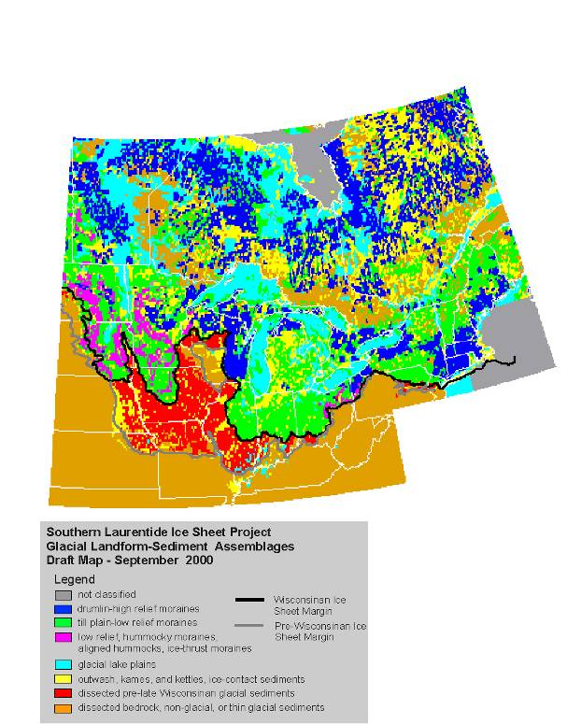

Slide 45
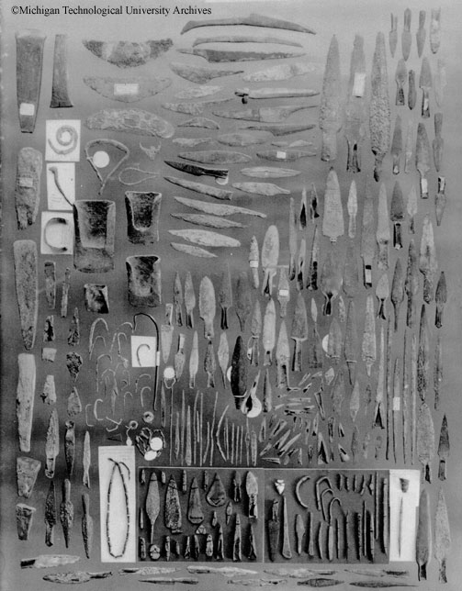

Slide 46
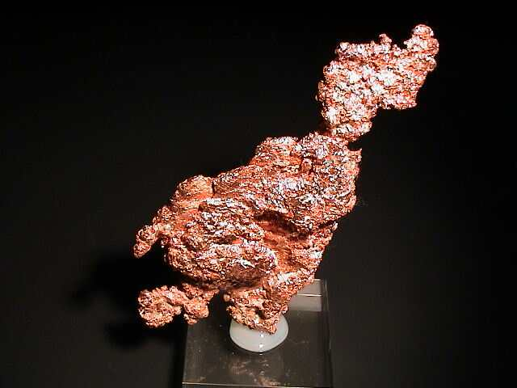

Slide 47
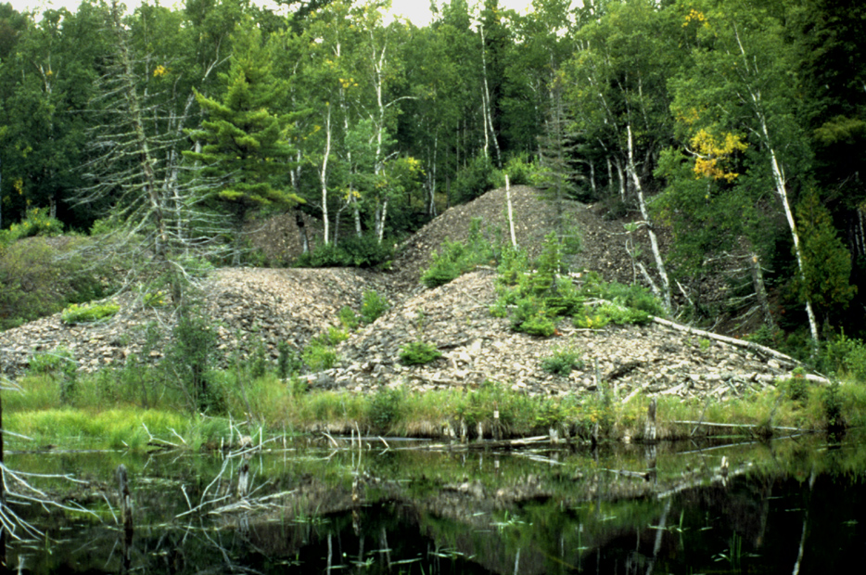
Notes:
Minong mine peor rock piles

Slide 48
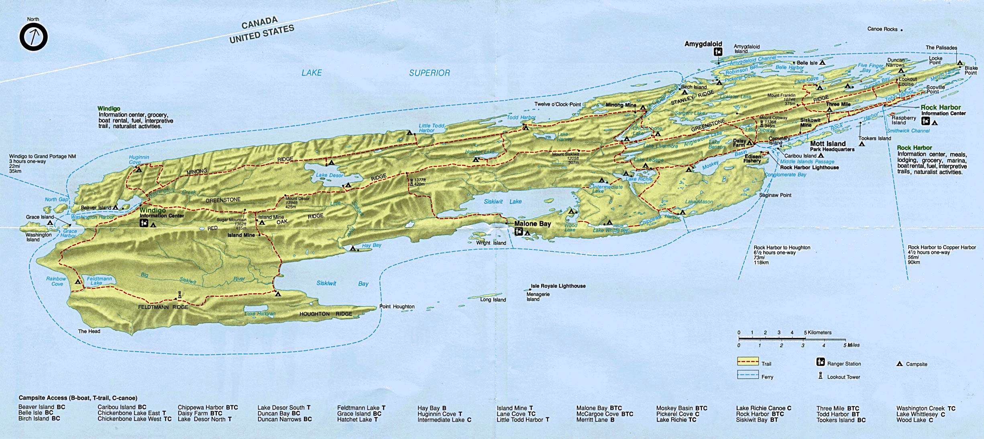

Slide 49
